Slide 1

Notes:
This is the Pre-Title Screen.
Please do not place any content on this screen.

Slide 2
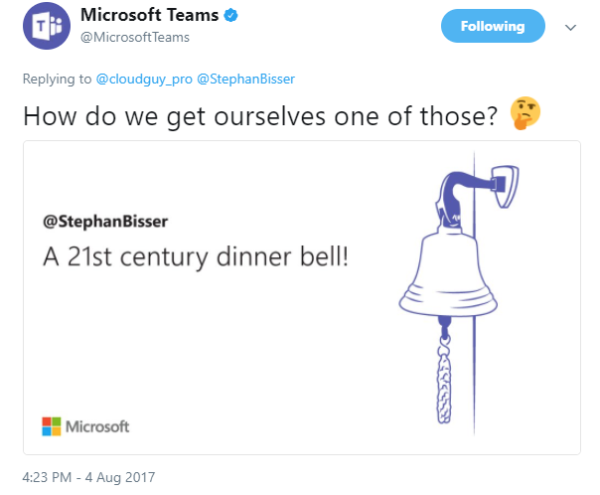
A 21st Century Lunch Bell Based on Cognitive Services, Azure IoT and Office365
lunch
Thomas Gölles & Stephan Bisser
Notes:
To add your image, please insert your picture and scale it to be bigger than the size of the white box shown.

Slide 3











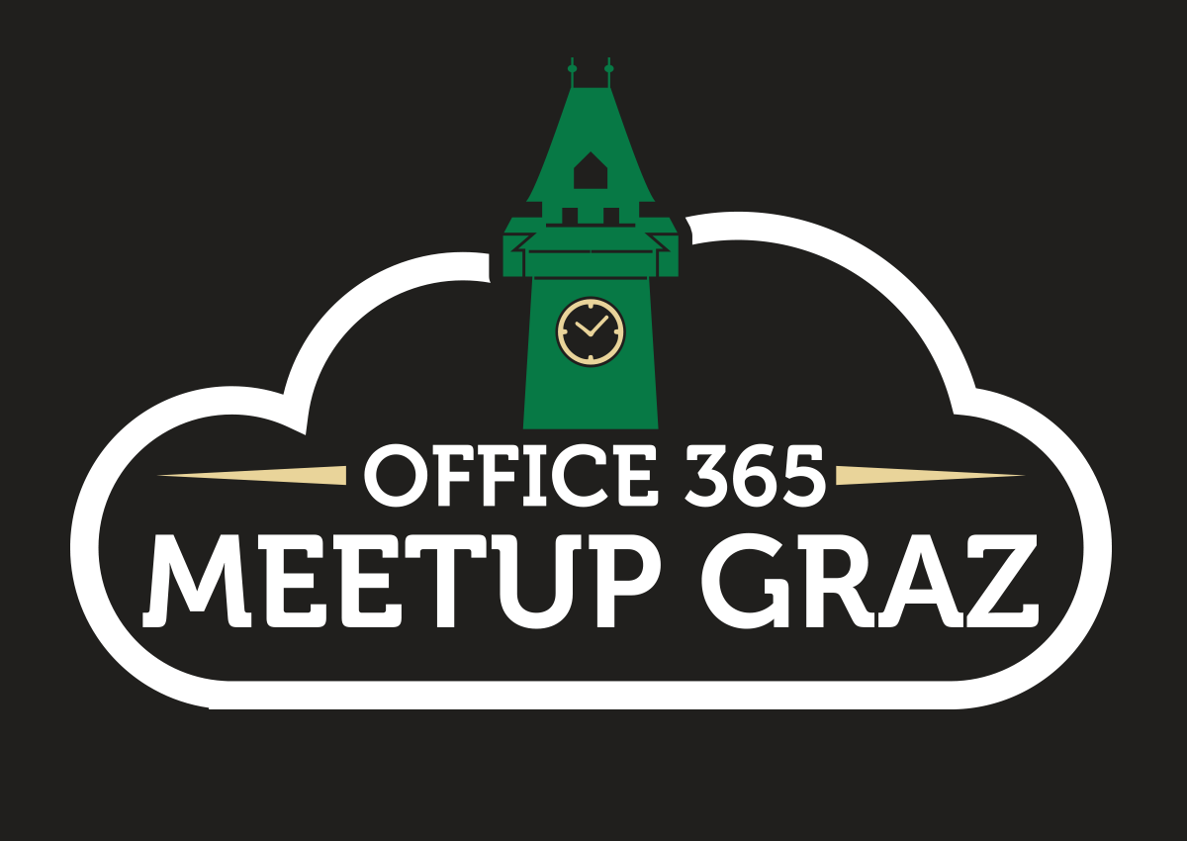
Thomas Gölles
Microsoft MVP (O365)
https://thomy.tech
@thomyg
Head of Modern Workplace Solutions
Graz, Austria
Stephan Bisser
Microsoft MVP (AI)
https://www.cloudguy.pro
@cloudguy_pro
#AskCloudguy
Graz, Austria

Slide 4

http://bit.ly/LEARN_TO_BOT

Slide 5
Agenda
1
Background
2
“Business Problem”
3
Architecture Design
4
AI 101
5
Tech geek out aka „Demo“

Slide 6
Background

Slide 7
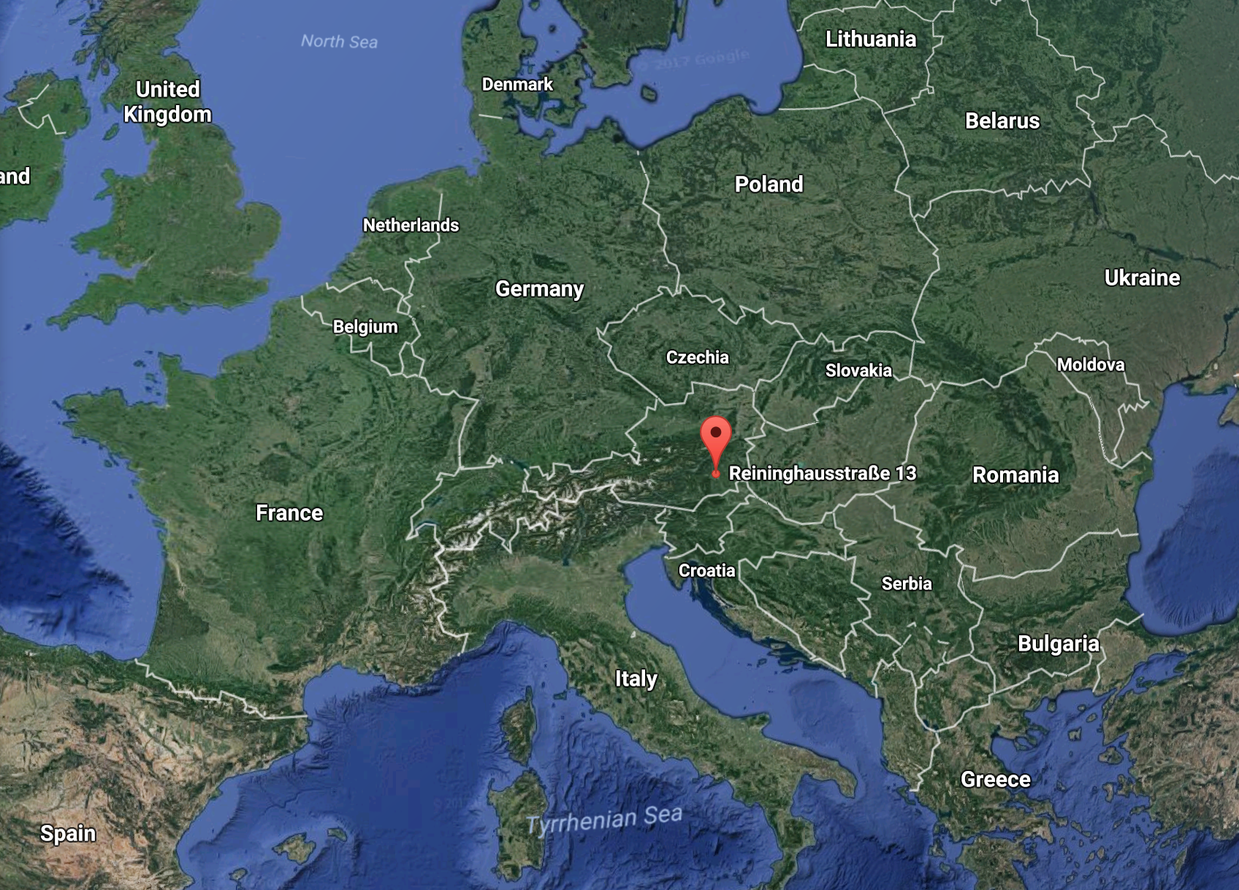
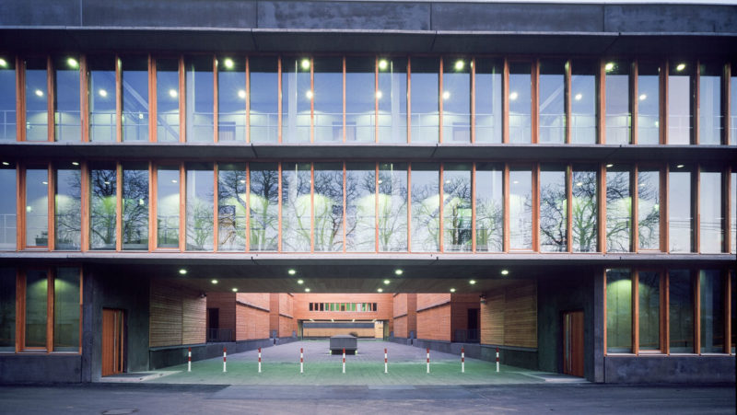
Our Office in Graz, Austria

Slide 8
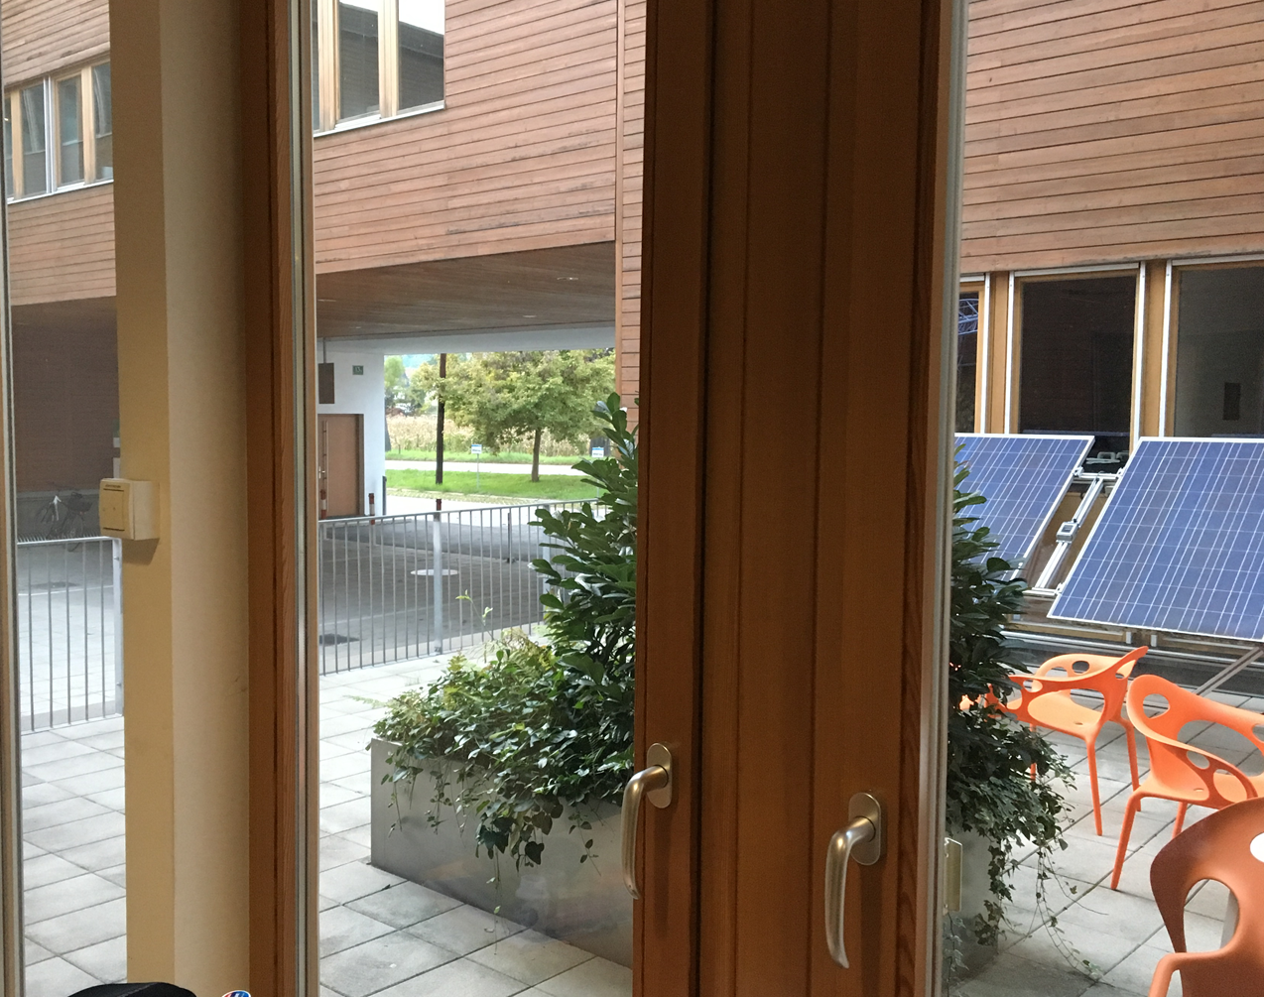
This was Thomy‘s view before he switched rooms

Slide 9
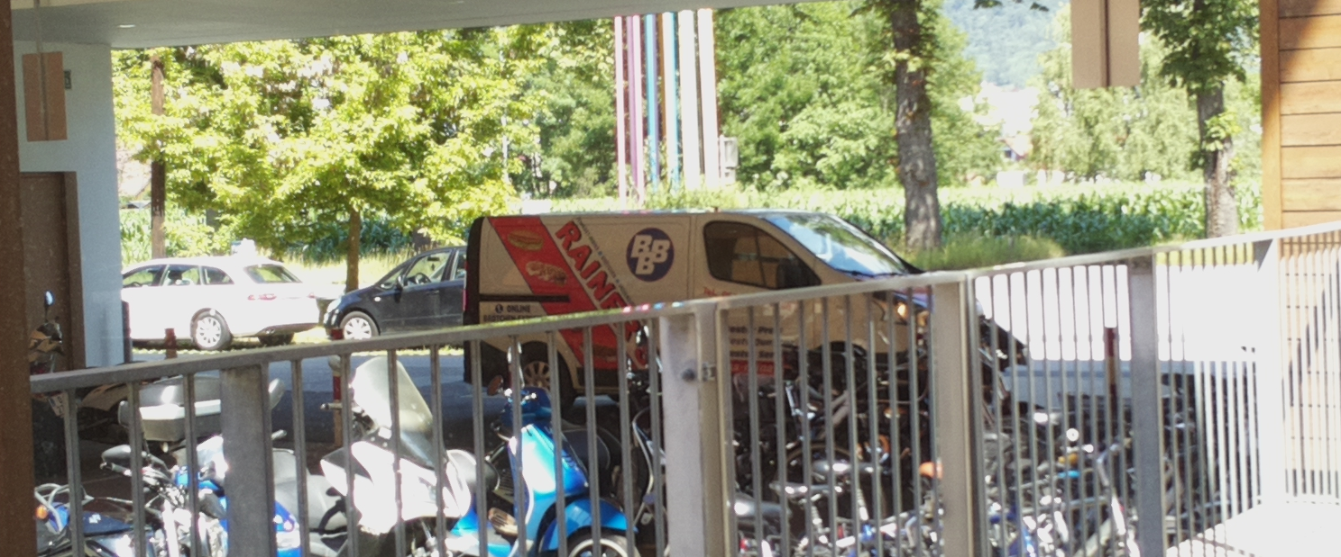
Lunchtime at our office (around 10:45)

Slide 10
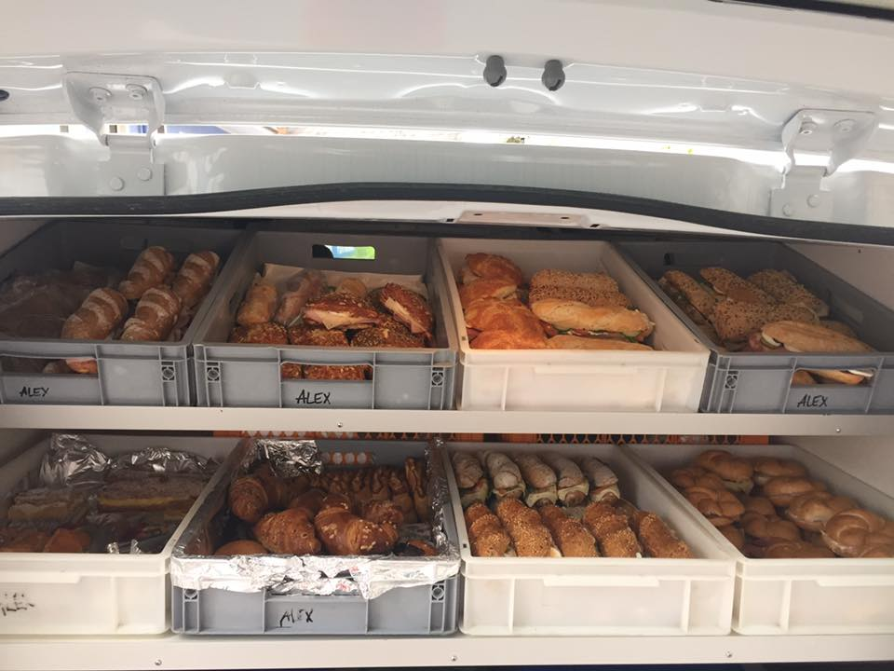
Delicious snacks

Slide 11
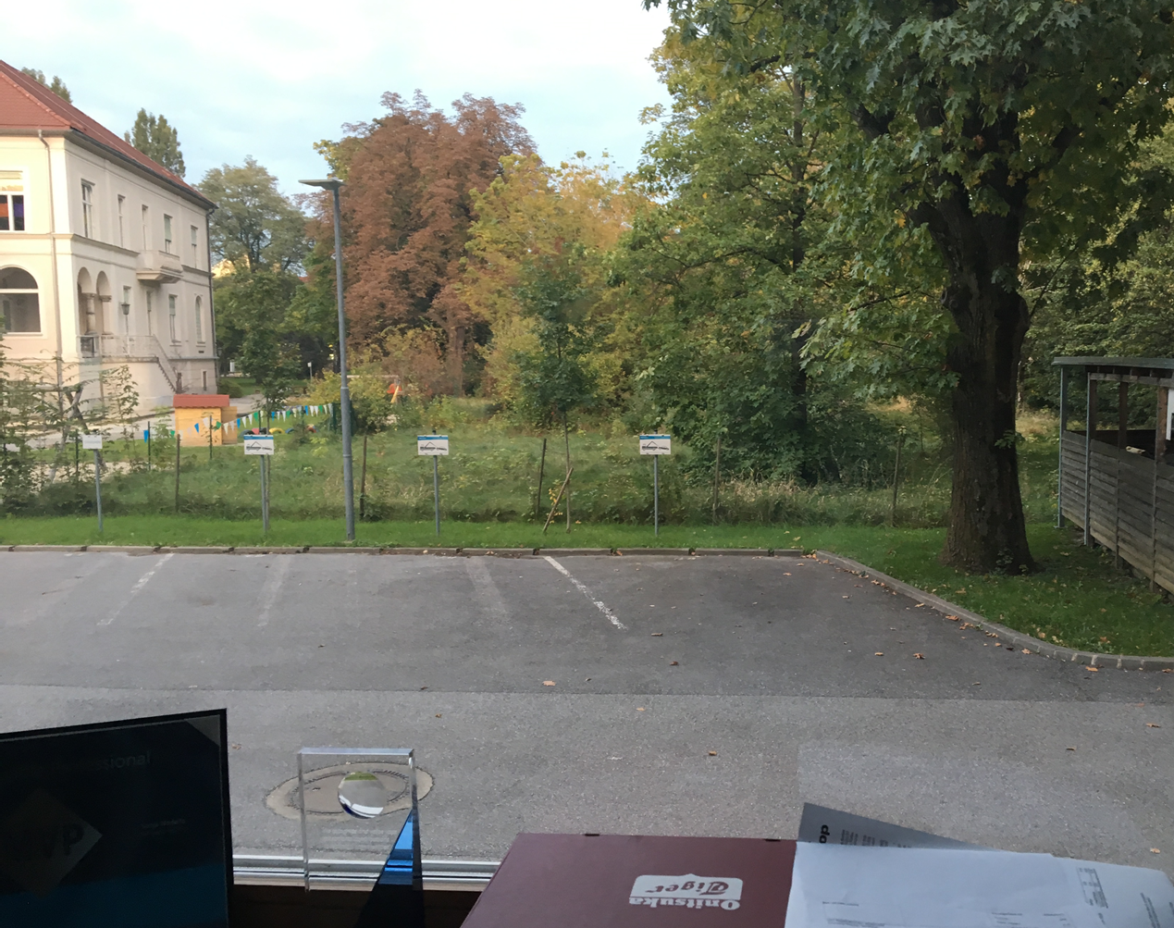
This is Thomy‘s view after he switched rooms (now)

Slide 12
How can Thomy solve that problem?

Slide 13
Possible solutions
Create a recurrent event in Outlook
“Ping” a colleague everyday
Stand up and have a look
Use technology to solve the problem

Slide 14
As a geek you have to do something awesome

Slide 15
MOCADESYMO was born
Penny:
Well, you know, it’s the Cheesecake Factory. People order cheesecake, and I bring it to them.
Leonard:
So, you sort of act as a Carbohydrate Delivery System.
Penny:
Yeah, call it whatever you want, I get minimum wage.
Mobile
Monitor

Slide 16
MOCA Who?

Slide 17
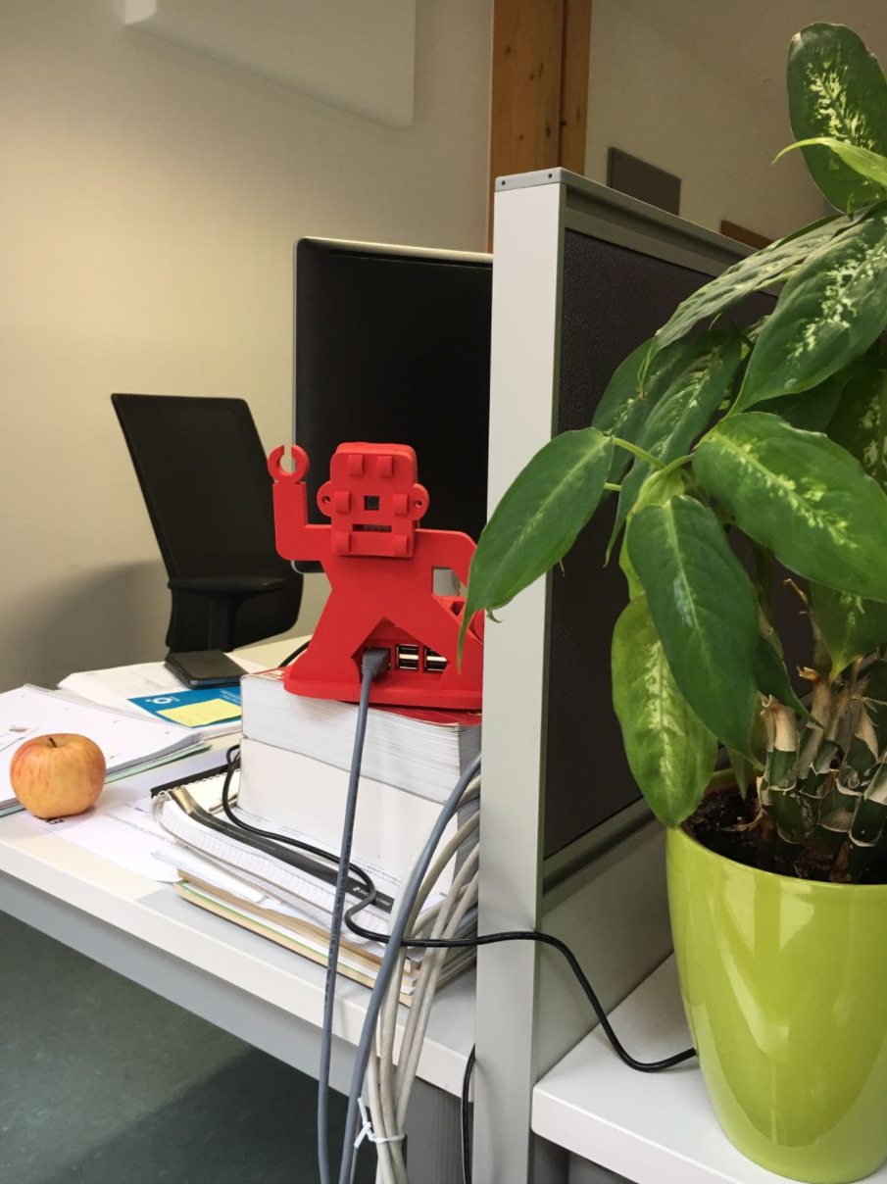
Hi, I‘m MOCADESYMO – your 21st century lunchbell

Slide 18
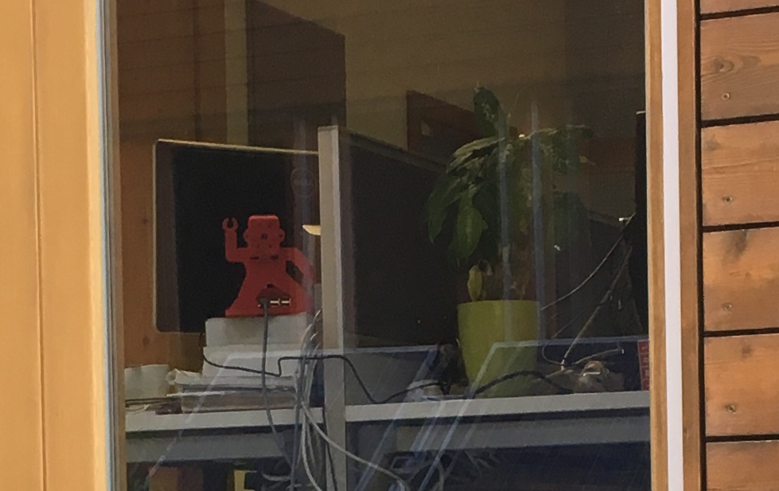
MOCADESYMO‘s view

Slide 19
Architecture Design

Slide 20
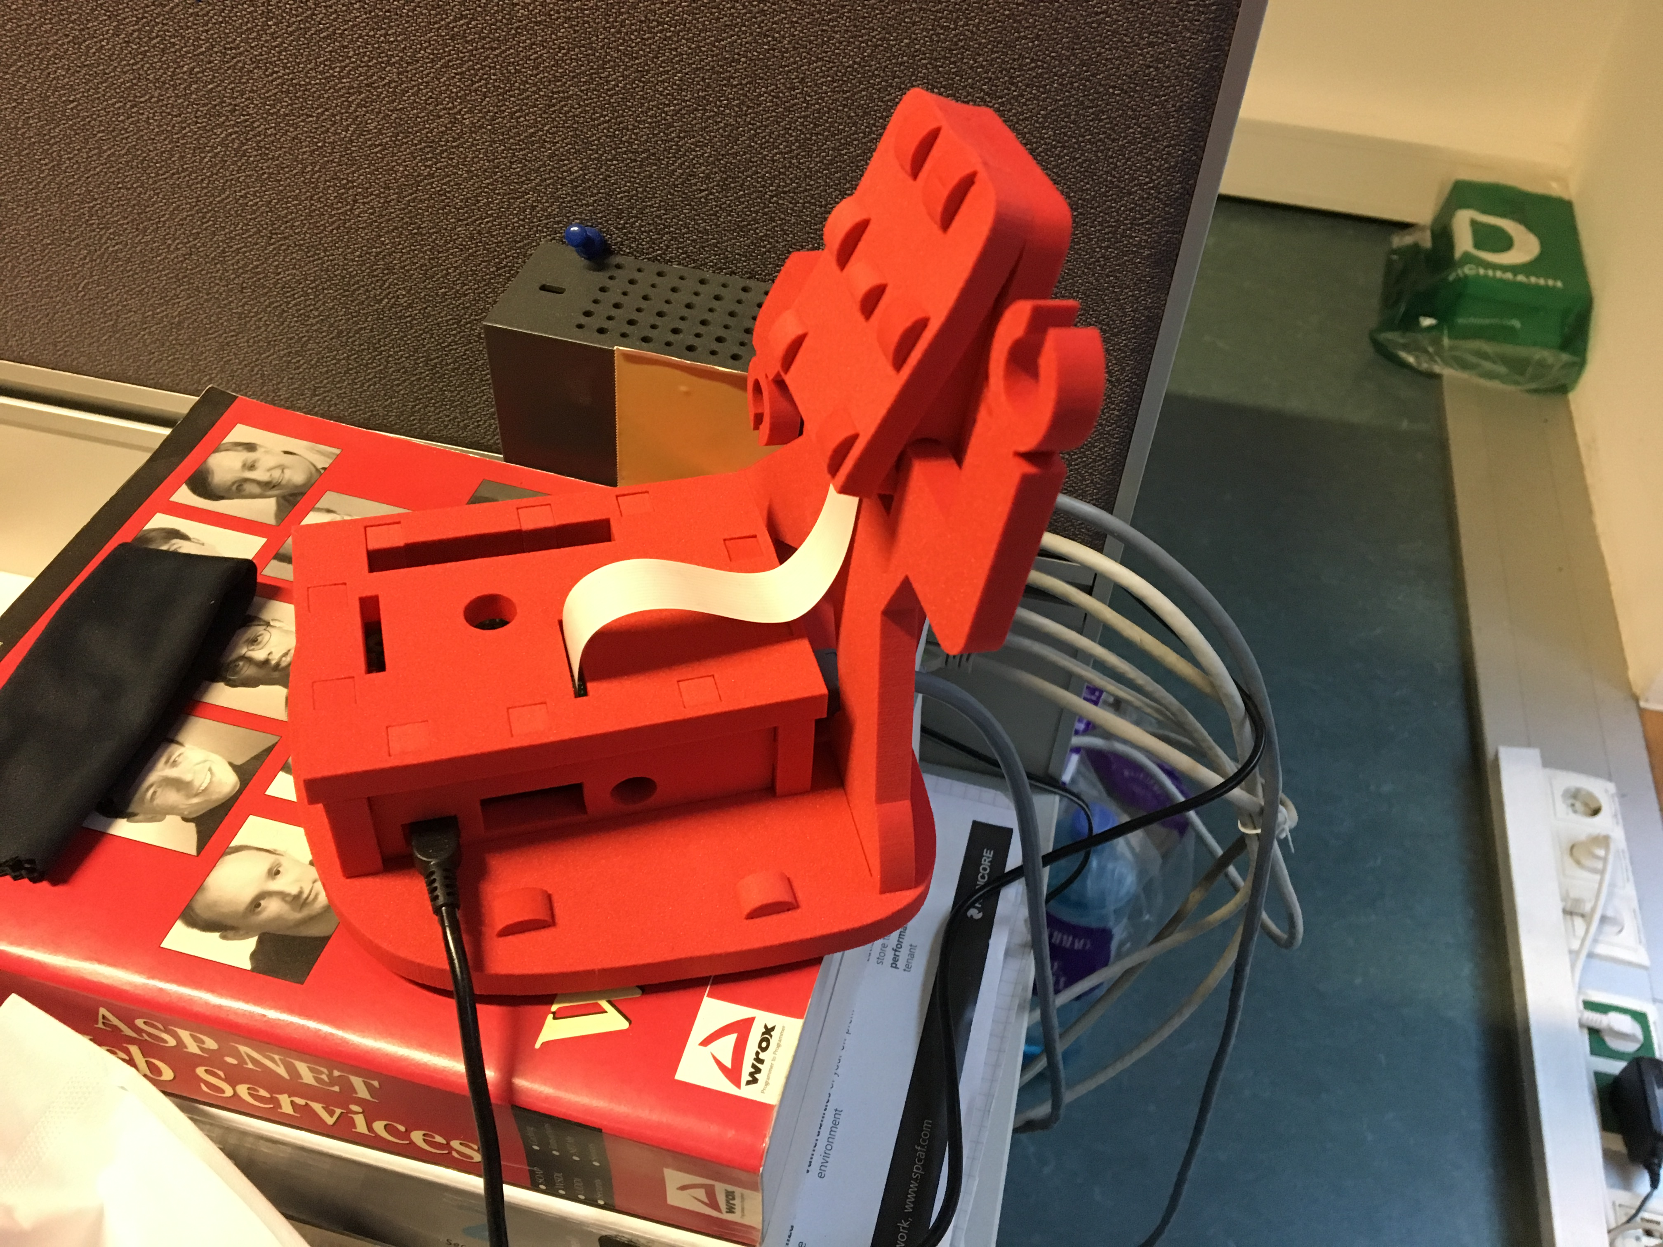
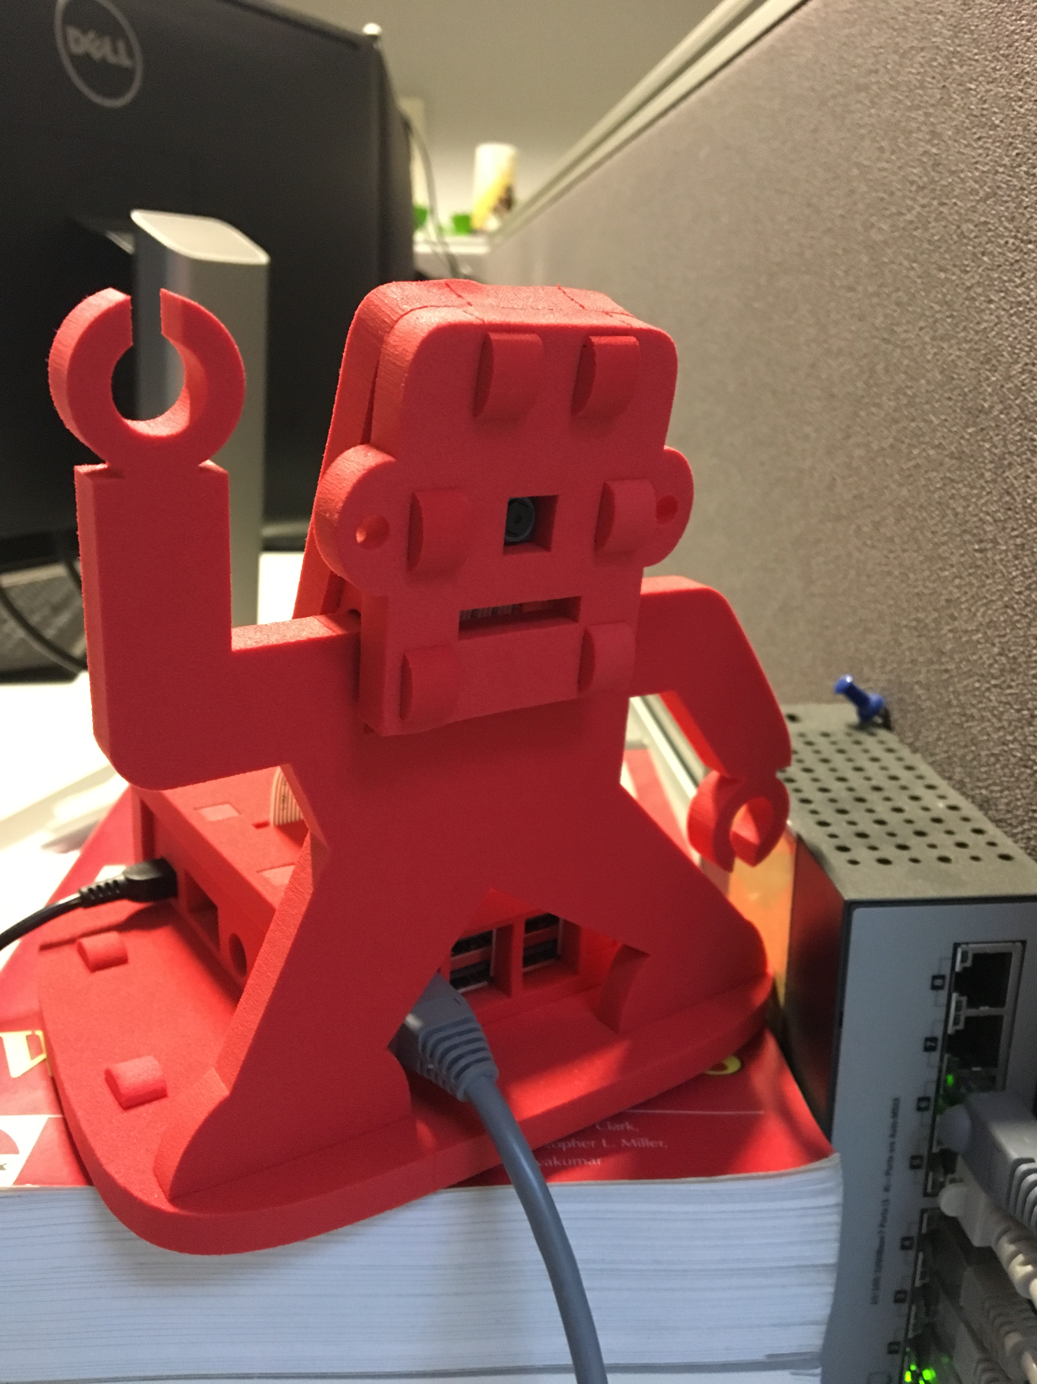
Raspberry Pi + camera module

Slide 21
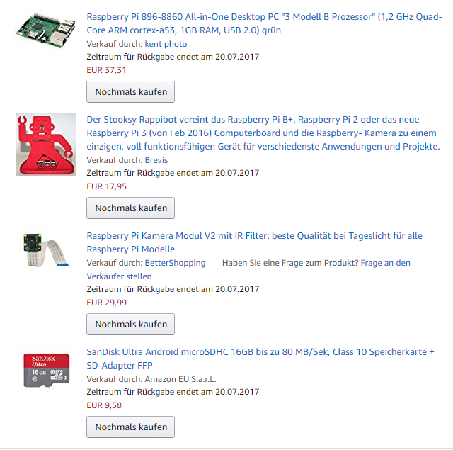
Parts

Slide 22
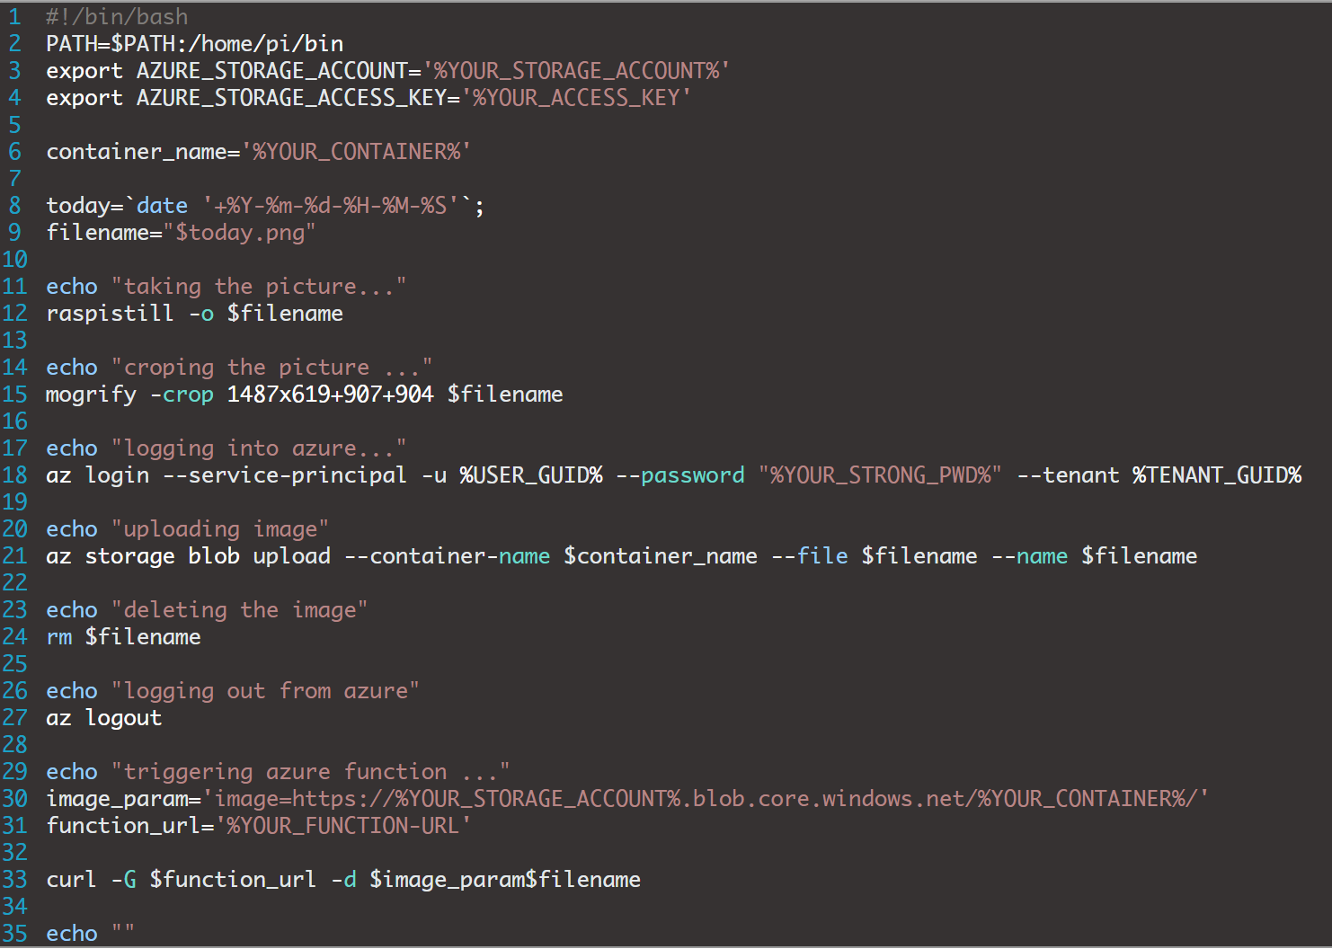
PI Shell script

Slide 23
Azure components
Blob Storage
Azure Function
Custom Vision API
Storage Tables

Slide 24
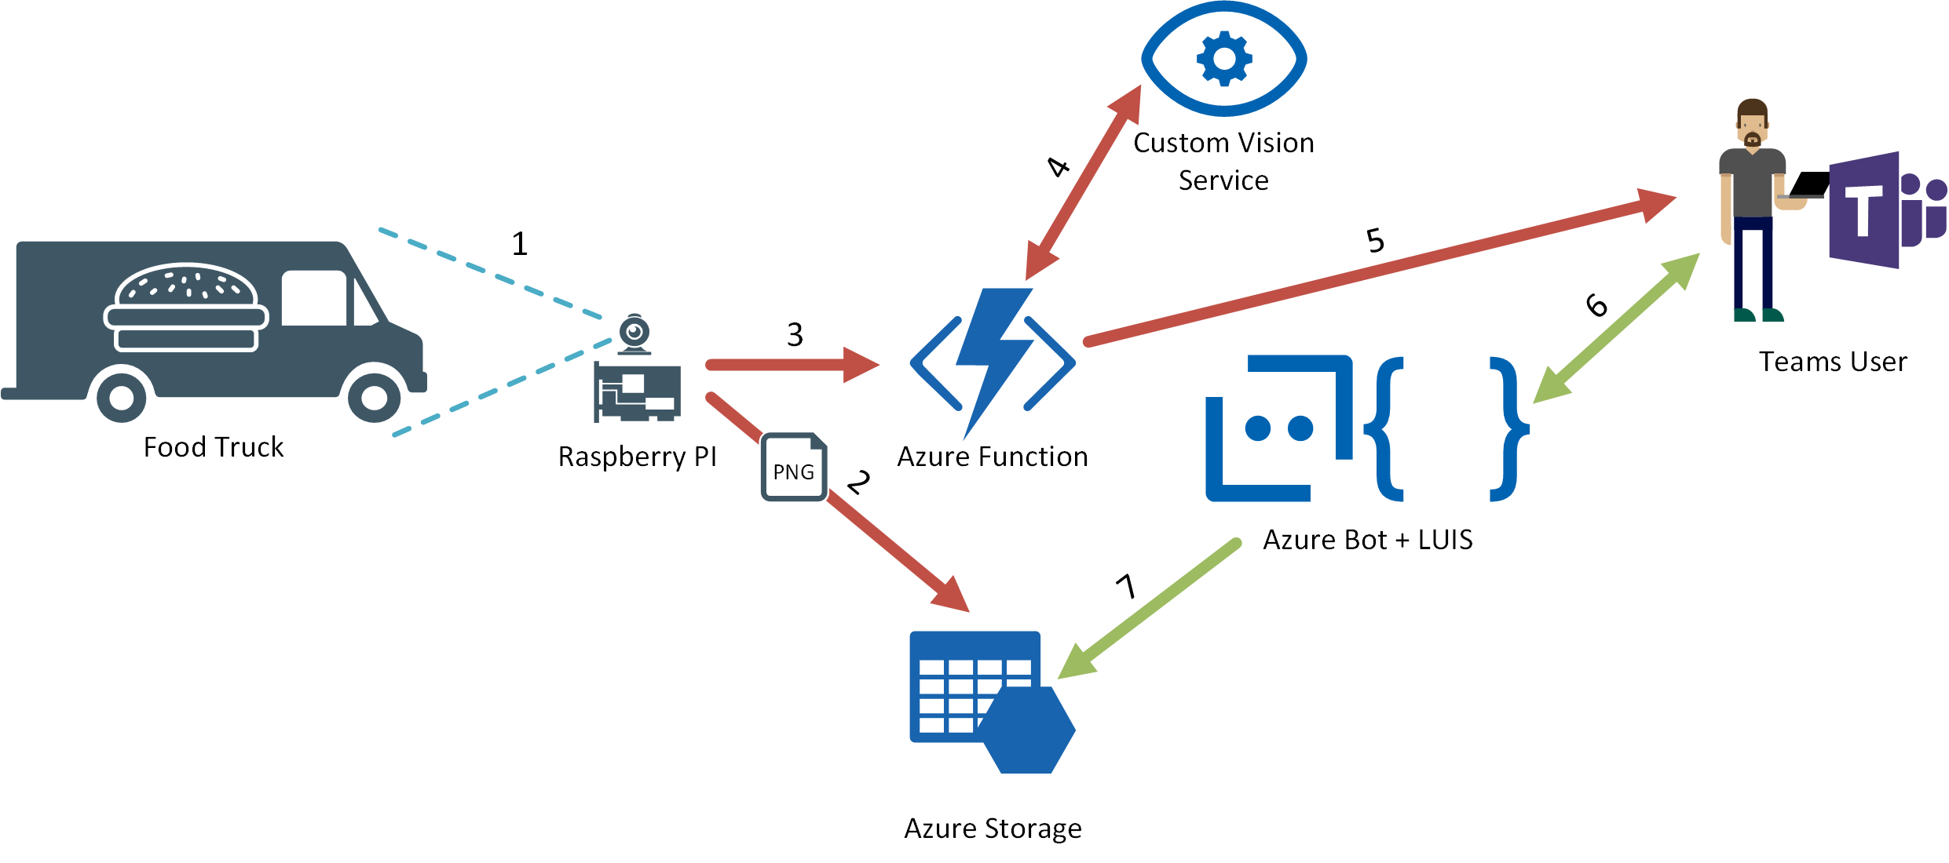
1. Raspberry PI camera takes photo of food truck, after it has arrived
2. Raspberry PI uploads the taken image into an Azure Blob Storage
3. Raspberry PI triggers an Azure Function after the image has been uploaded successfully
4. Azure Function calls the Custom Vision API in order to check wether the food truck is present or not
5. If Custom Vision API responds with a high probability that the truck has arrived, the Azure Function sends a notification to Teams
6. Users can ask the Lunchbell Bot in Teams wether the food truck has arrived or not or if it is still present
7. Azure Bot Service checks the entries in an Azure Table Storage where the arrival and departure time is stored

Slide 25
AI 101

Slide 26

1990s: Internet
Search
User “visits” websites
The future: Conversations
Natural language between people and technology
Conversational canvas
Bots and agents
The evolution of computers and IT
1980s: PC
Desktop
2000s: Mobile
Social
User download apps from App Stores
1989 SQL Server
1993 Exchange
2001 SharePoint
2010 Azure

Slide 27
Conversational AI
Conversational AI is a subfield of artificial intelligence focused on producing natural and seamless conversations between humans and computers
A new user interface paradigm
Exposes software services through conversational interface
In apps, browser and on IoT devices
Pro-active capabilities (Virtual Assistant etc.)
Bots
……

Slide 28
Bots 101
“a computer program designed to have a conversation with a human being, especially over the internet” *
* https://dictionary.cambridge.org/dictionary/english/chatbot

Slide 29
Bots 101
It’s one thing: it’s an app that performs an automated task
It solves the user’s needs in the quickest/easiest way compared to any other option... like an app, or a website

Slide 30




Bots 101
Platform
Platform services
HTTP
AI
{ Your Code }
Intelligent tools
REST Endpoint
SDK
Bot builder SDK
REST endpoint
Direct Line Protocol
Conversational and business logic
Canvas aware
Context sensitive

Slide 31
Microsoft Conversational AI Landscape

Slide 32













Channels
Knowledge
Sources
Conversational AI
Azure Bot Service + Cognitive Services
General Knowledge
Knowledgebases
AI Capabilities
User
Input
Azure Bot
Services
Data Sources
Speech
Bot Features:
Personality
Dialogs
Language Model
Tap
Adaptive Cards
Type
Speak
QnA
Language Understanding
Vision
Devices
LOB Apps
On premises
Enterprise stores

Slide 33
The Lifecycle of your Project
Comprehensive framework for the lifecycle of your project
Plan
Build
Test
Publish
Connect
Evaluate
Author Dialogs
Design Cards
Visualize
Bot Builder SDK
Cognitive Services
Getting Started Templates
Emulator​
Application Insights
Conversation Transcripts
DevOps Tools
Azure
BYO Web Host
WebChat
Cortana
Skype, FB
+
Custom (DirectLine)
Application Insights
LUIS Suggestions

Slide 34
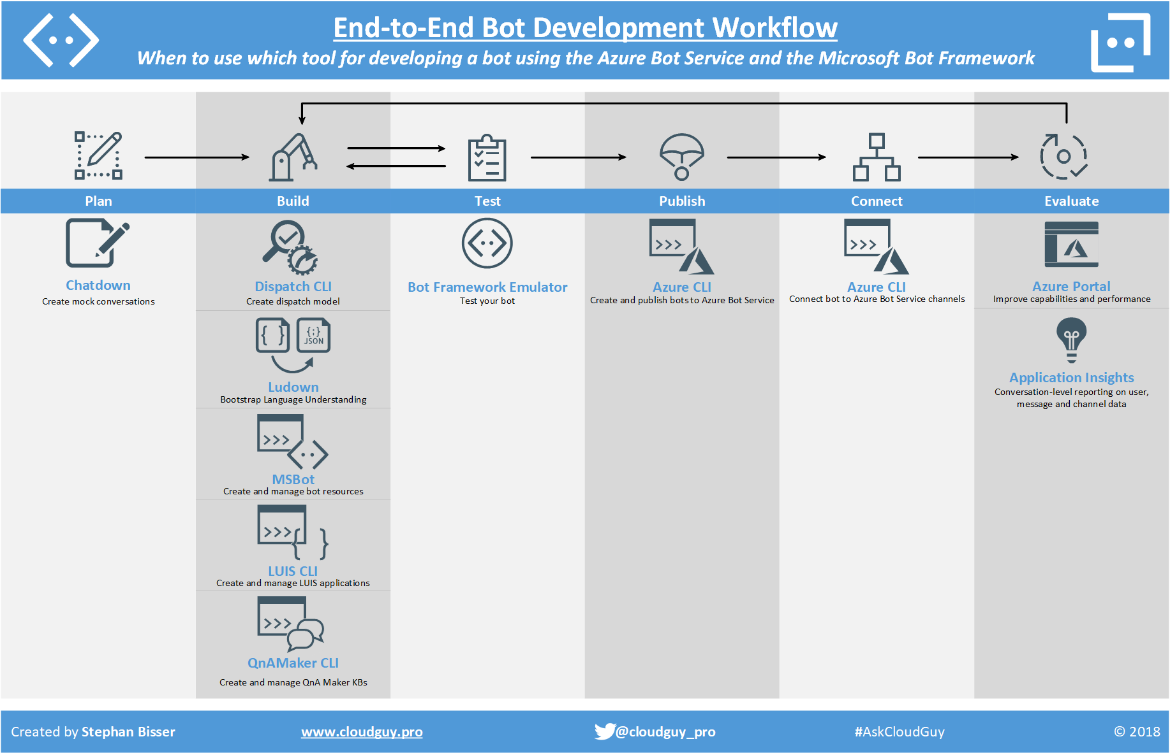

Slide 35
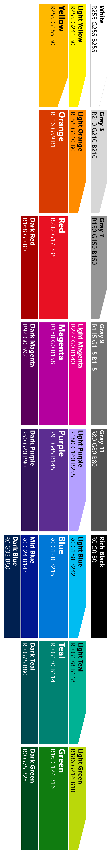
Modelling your conversation
Roll your own
state management etc.
Multi layered conversations
Bespoke
Dialogs
Data capture,
“Web forms” scenarios
Flexibility
FormFlow
FAQs,
command & control
QnA
Effort to implement

Slide 36

Conversational mechanisms
Text, with optional media attachments
Traditional chat, can contain media attachments (e.g., image, video, audio, file)
Input prompts
Suggested actions: Buttons, numbered items in a list, etc.
Rich cards, rendered as a list or carousel
Images, buttons, audio, animations, video, user sign-in, etc.
Hero | Audio | Animation | Thumbnail | Receipt | Sign In | Video | Adaptive | Purchase
Speech
Text-based chat using Speech Recognition & Synthesis (TTS)

Slide 37
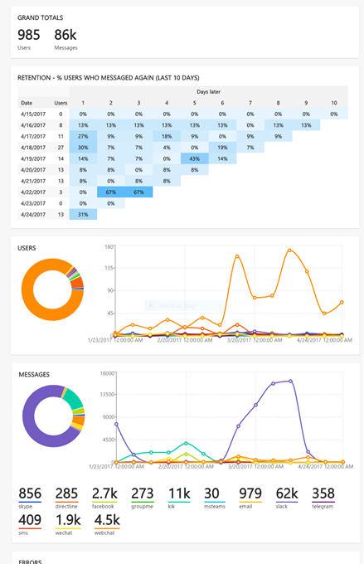
Continuous Improvement
Instrumentation provided by App Insights; added by default in Bot Service
Extend instrumentation through AI SDK
If you are not building bots that will actually be used, then you are not building bots

Slide 38
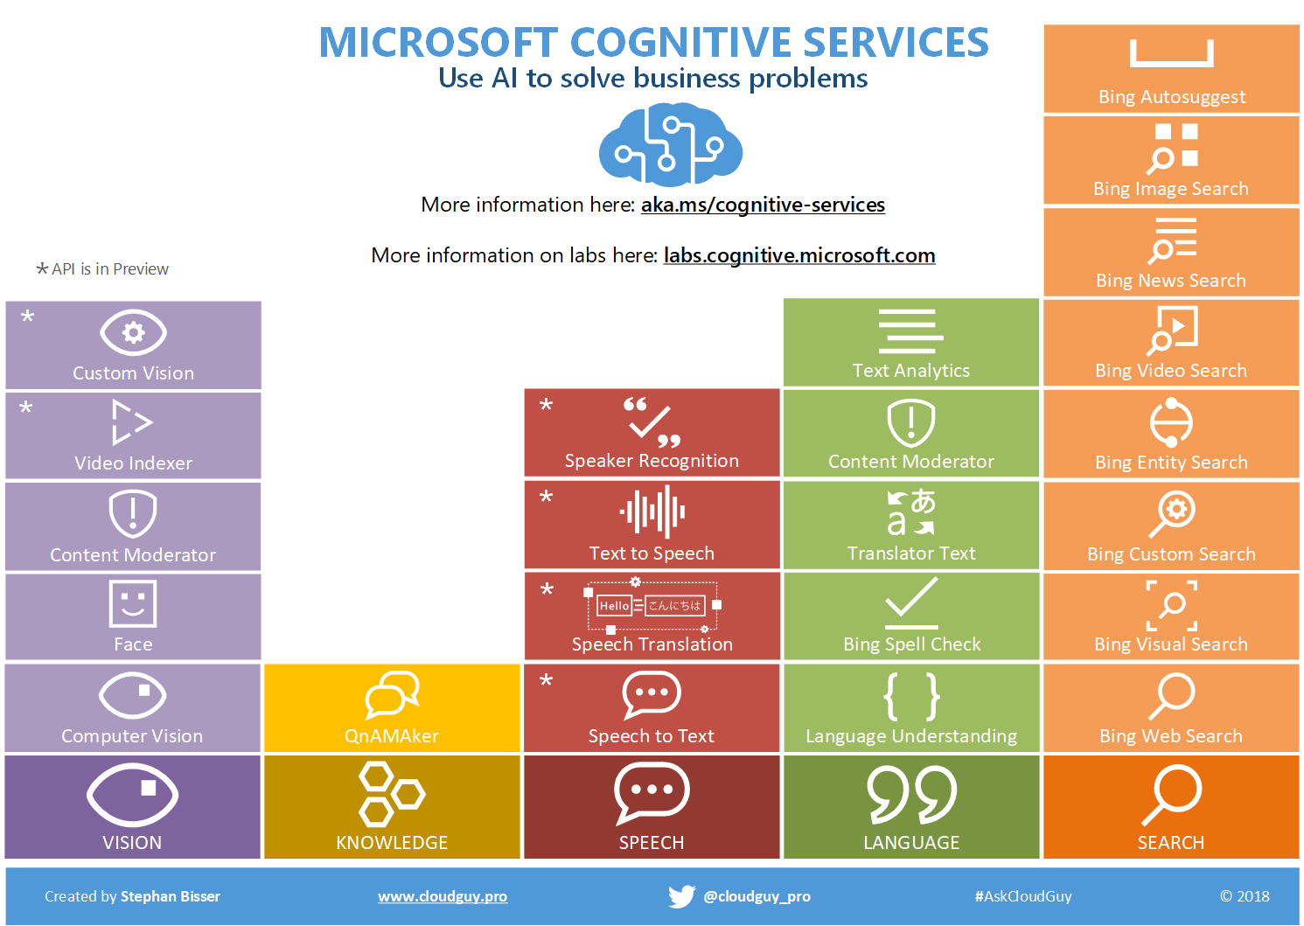

Slide 39
Custom Vision Service
Build a custom image classifier in 10 minutes or less
Diversity of images is key: angles, lighting, backgrounds
Handles tuning model for edge cases (like misses)
Upload
Start with as little as 30 – 50 images per tag
Train
Build model on one of five featurizers
Predict
Deploy REST endpoint; identify 1+ tags
Iterate
New images are retained for tagging

Slide 40
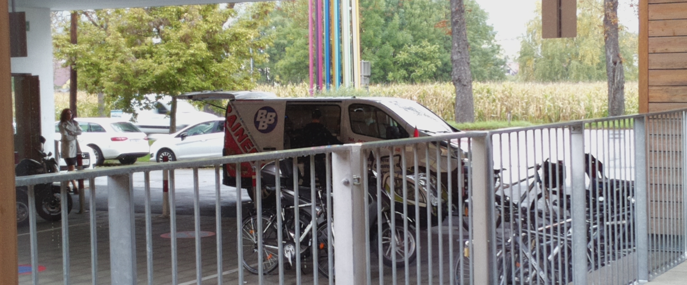
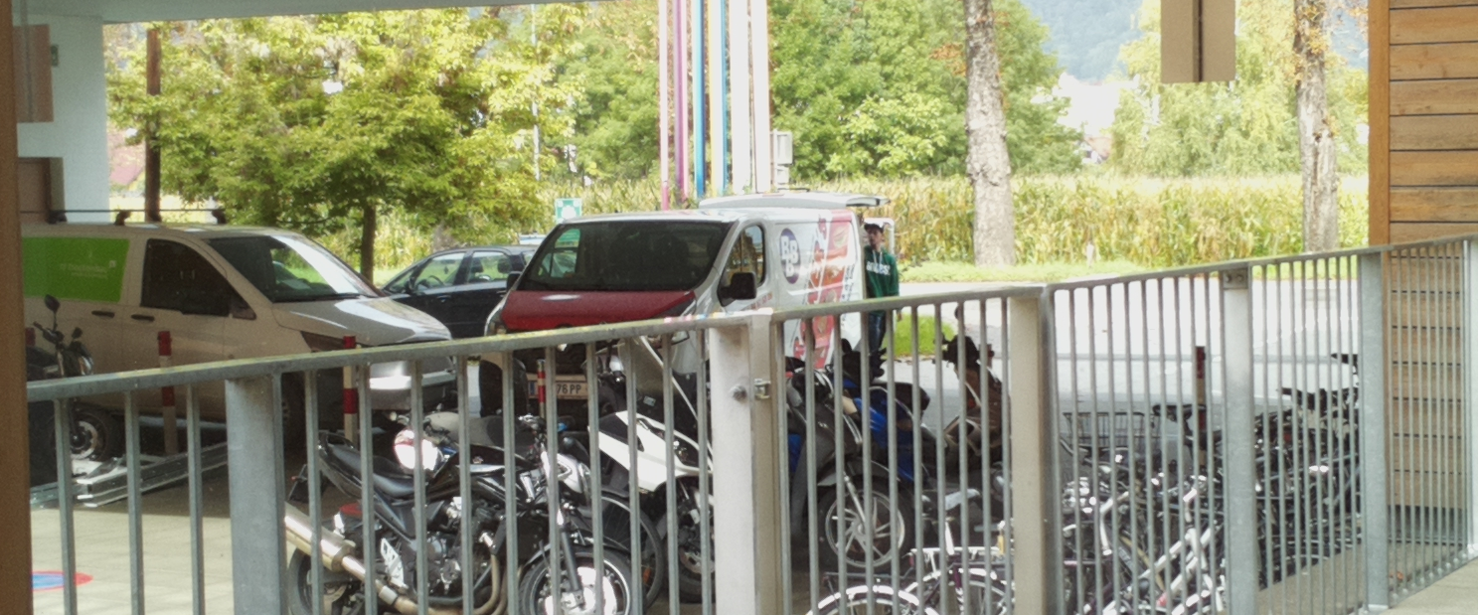
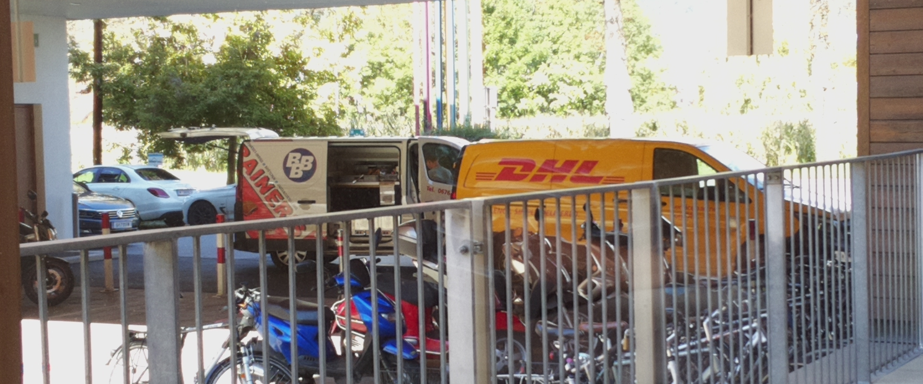
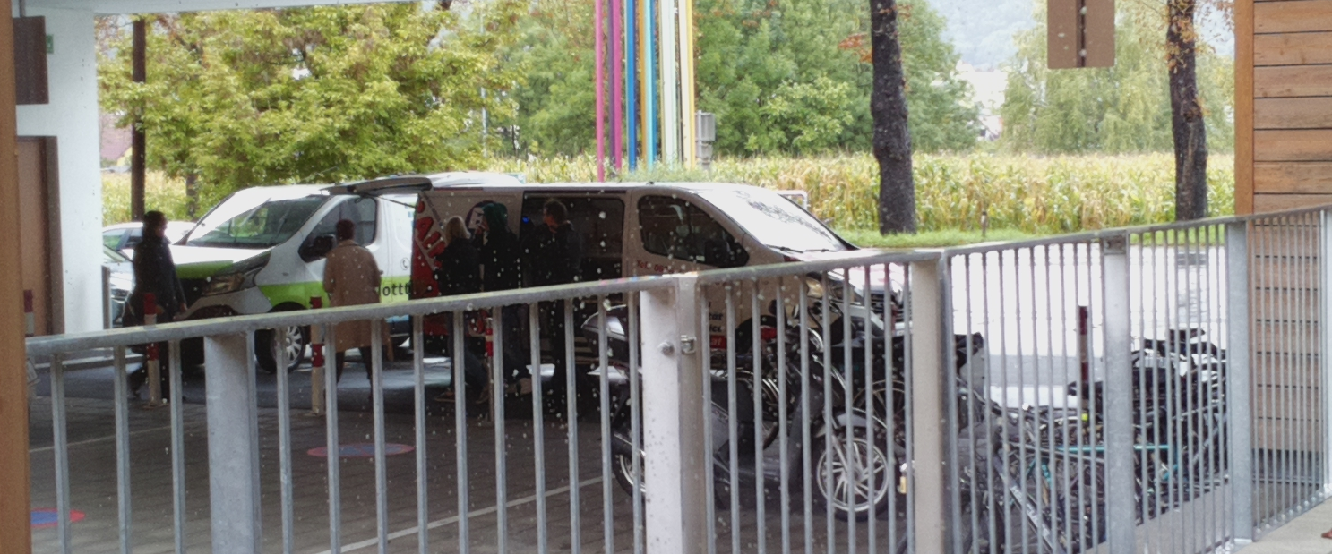
Custom Vision Service
99,9 % True
100 % True
Normal State
98,53 % True
Notes:
SBI

Slide 41
Language Understanding
„Has the food truck arrived?“
„Has the food truck arrived?“
[ $LunchBell.Object ] [ $LunchBell.Operation ]
Intent = CheckArrivalState
www.luis.ai
Notes:
LU converts from the words in a sentence into a machine-readable meaning representation, typically indicating the intent of the sentence and any present entities

Slide 42
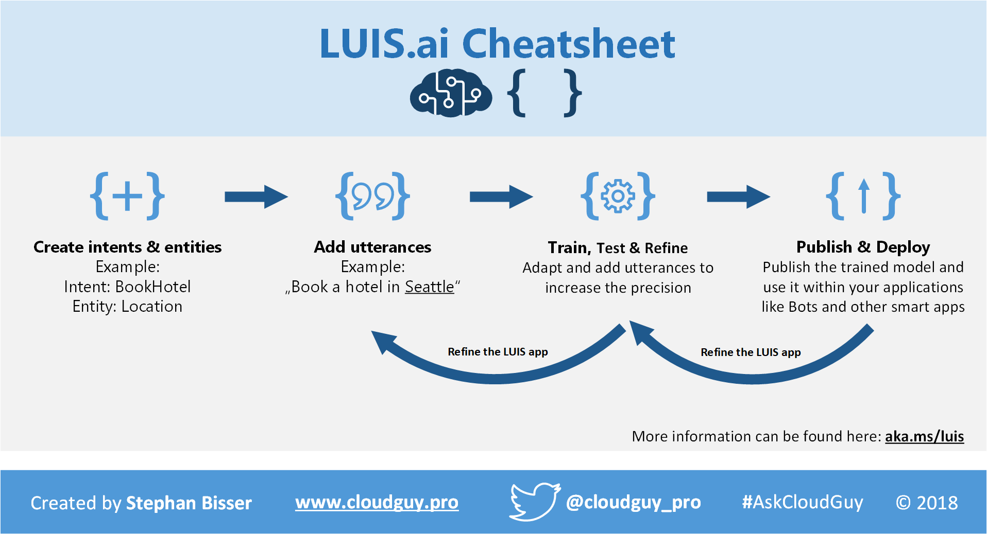

Slide 43
Where does the lunchbell ring?

Slide 44
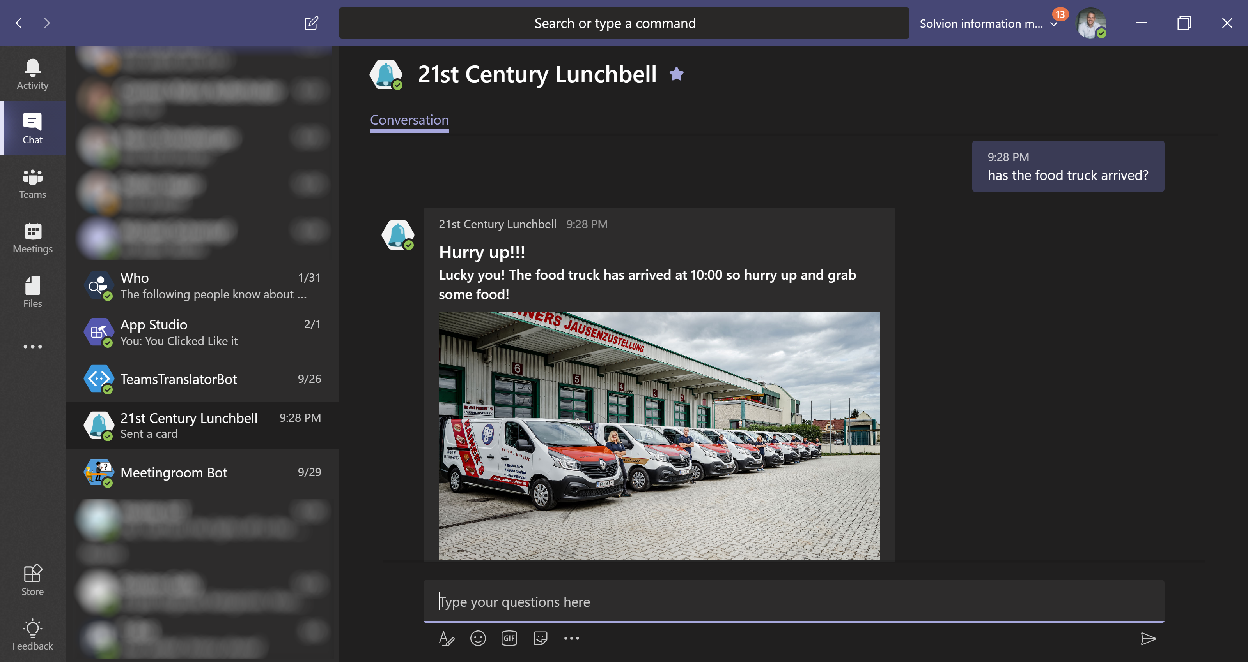
Microsoft Teams

Slide 45
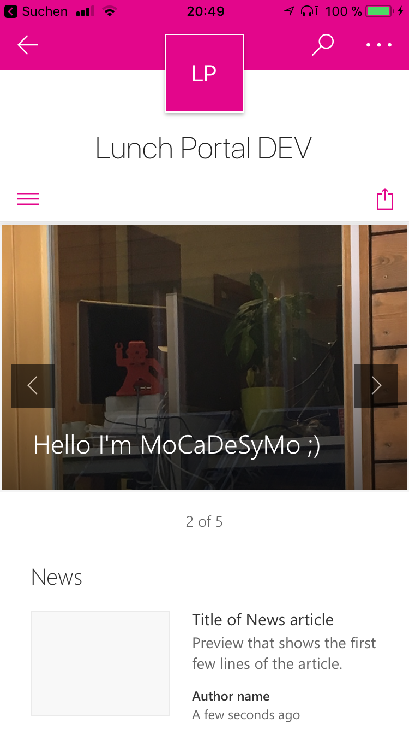
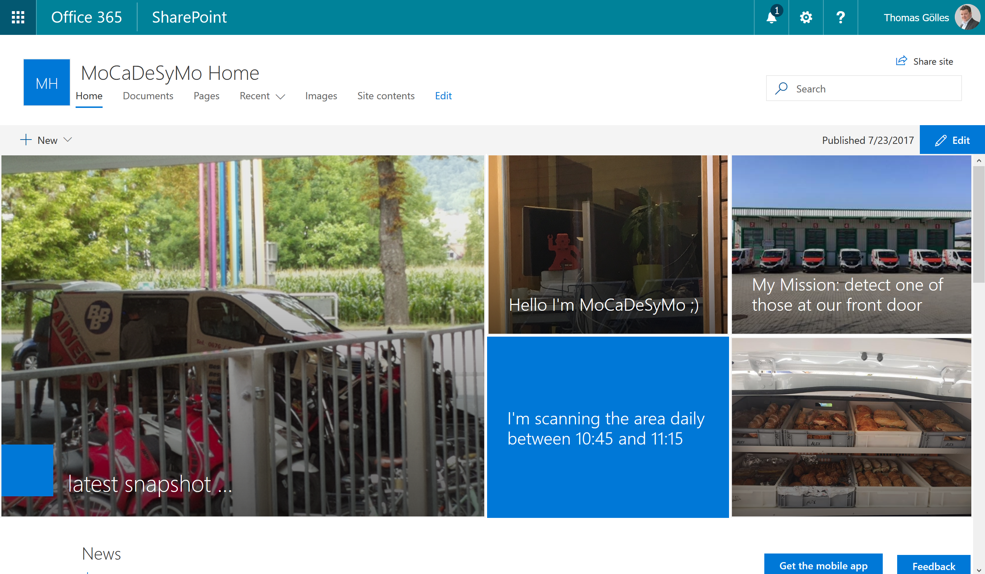
SharePoint Online

Slide 46
Demo

Slide 47
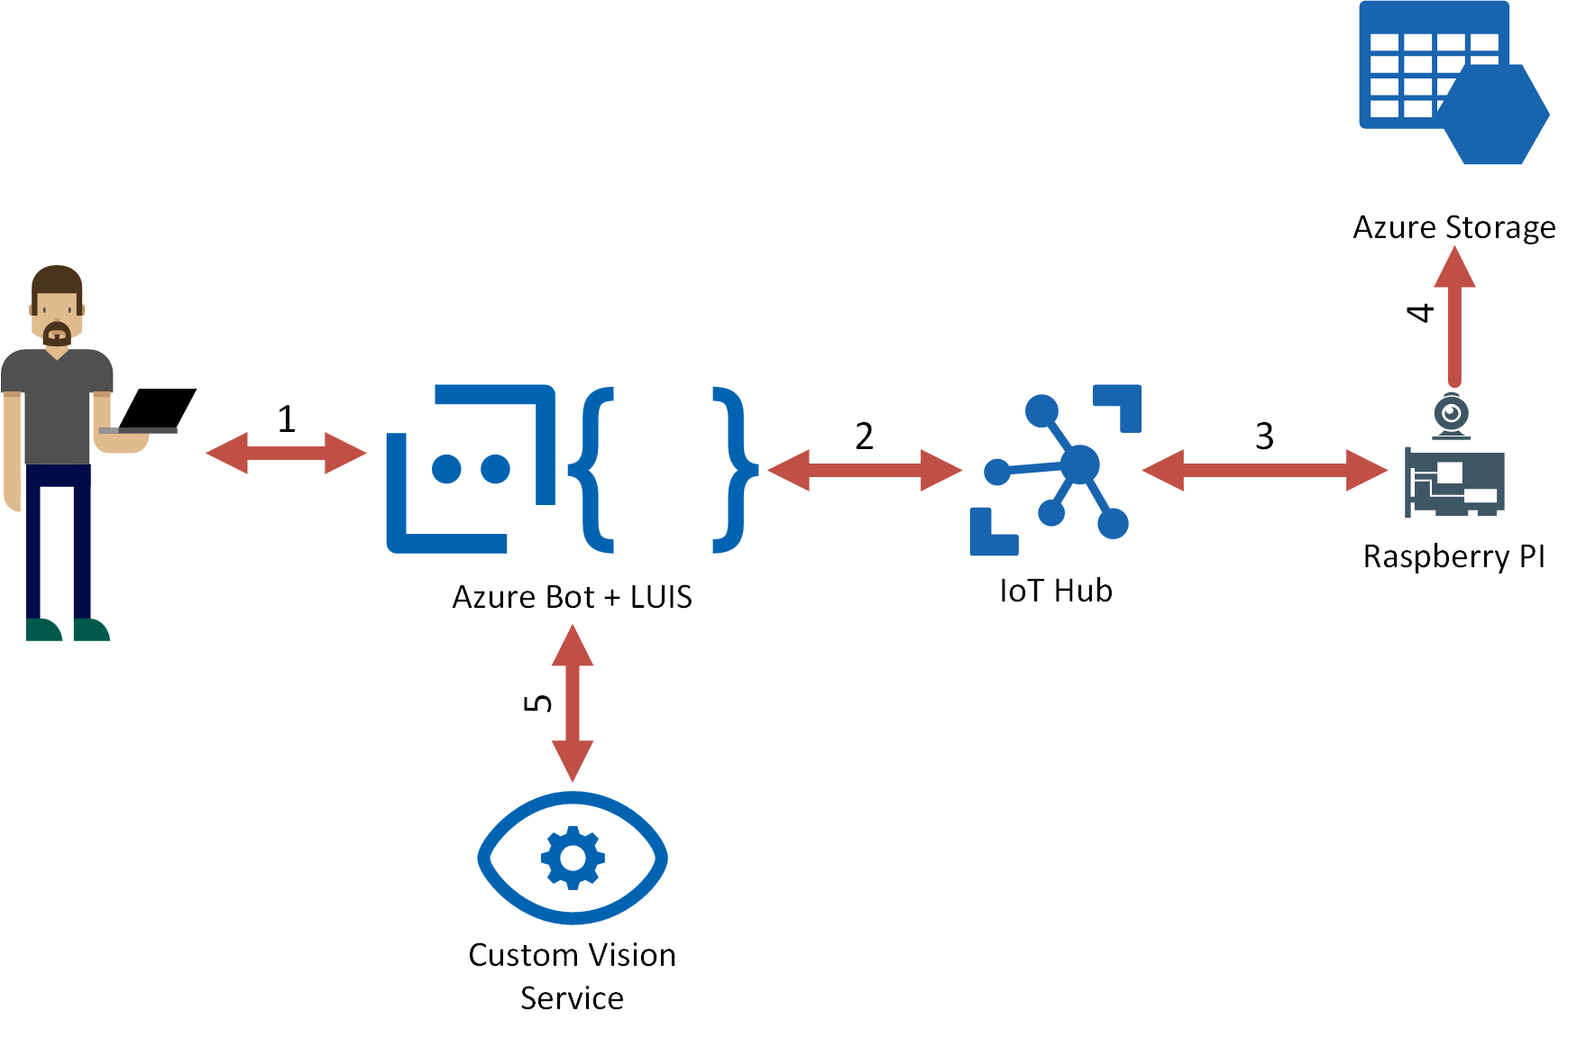
Demo Case

Slide 48
THANK YOU!
Code, slides and other resources available at:
http://bit.ly/LEARN_TO_BOT

Slide 49
http://bit.ly/LEARN_TO_BOT
THANK YOU!
Thomas Gölles
Microsoft MVP (O365)
https://thomy.tech
@thomyg
Head of Modern Workplace Solutions
Graz, Austria
Stephan Bisser
Microsoft MVP (AI)
https://www.cloudguy.pro
@cloudguy_pro
#AskCloudguy
Graz, Austria

